Slide 1
Pros and Cons of Different options
Options:
Each request from a TCN starts a CHC process. Multiple CHC processes at the same time
Each request from a TCN sets a flag. Only a single CHC process at the same time
What this algorithm provides?
Each TCN can start only 1 CHC process. This limit can be upgraded by agent designer. However, there should definitely be a limit. Otherwise, a TCN can start as many CHC processes as he wants which is not desirable.
TCNs don’t have to wait for a CHC process to be completed.
TCNs will receive a solution for each CHC process that they are involved in. Each solution they receive will have a time stamp which means the solutions can be sorted from newest to oldest. Also each TCN will be able to view his/her preferences for each CHC solution.

Slide 2
CHC Coordination Protocol
Multiple Processes Simultaneously
Algorithm 1. Request CHC Process
Event: TCN requests a CHC process from its Agent
Condition: Its Agent checks the LAKR to see “If it already runs a CHC process as Dedicated agent”.
If YES,
Event: Agent sends a message to TCN telling that “You have already started a CHC process. You can start a new one when it is completed.”
If No,
Condition: Agent checks the LAKR to see “If it is involved in any CHC Process”.
If YES,
Event: You are already involved in a CHC process, do you want to start a new one?
Condition: Does the TCN want to start a new CHC process?
If YES,
Event: start Algorithm 2: Initiate CHC Process
If NO,
Abort
If NO,
Event: start Algorithm 2: Initiate CHC Process
Algorithm 2. Initiate CHC Process
Event: Agent sends a message to TCN telling that “I am starting a CHC process and will inform you when the result is ready“.
Event: start Algorithm 3: Compute CHC
Event: receive the output of Algorithm 3: Compute CHC
Event: send the output to TCN. Output should include: 1) solution of CHC process and 2) a flag indicating whether the Agent is available to start a new CHC process.

Slide 3
CHC Coordination Protocol
Multiple Processes Simultaneously
Algorithm 3. Compute CHC
* TCN’s agent acts as Dedicated agent
Event: Dedicated agent informs WPM that it is “In_Coordination” and populates LAR.
Event: Dedicated agent sends a message to all agents who are either “Active” or “In_Coordination” state. It requests those agents to return their Personal Info. Receiver agents run Algorithm 4: Personal Info Request
Condition: Dedicated agent waits for some amount of time to receive all the Personal info. If any agent doesn’t return its info in this time, Dedicated agent proceeds without it.
Event: Once Dedicated agent collects all Personal info or the time expires, it broadcasts the Complete Personal Info to all participating agents.
Event: Dedicated agent requests participating agents to return their Similarity values. Receiver agents run Algorithm 5: Similarity Values Request
Condition: Dedicated agent waits for some amount of time to receive the Similarity Values from all participating agents. If any agent doesn’t return its info in this time, Dedicated agent asks one more time and waits again. If the result is same, then it proceeds without this particular agent.
Action: Once Dedicated agent collects all Similarity values or the time expires, it runs Algorithm 6: Solve Constrained Clustering Problem and gives the Asymmetric Similarity Matrix as the input.
Event: Dedicated agent sends the Output of Algorithm 6, to other participating agents and informing them that the CHC solution is computed. Dedicated agent and receiver agents run Algorithm 7: Share CHC Solution with TCN
Algorithm 4. Personal Info Request
Event: An agent receives the request to return its Personal Info to Dedicated Agent
Event: Agent sends its Personal Info to Dedicated Agent
Event: Agent informs WPM that it is “In_Coordination”
Algorithm 5. Similarity Values Request
Event: When an agent is requested to send its Similarity values for a CHC process, it executes the following steps.
Action: It computes all pairwise similarities by comparing its Individual Preferences with the Personal info of all other participating agents
Event: It sends the Similarity values to the dedicated agent
Algorithm 6. Solve Constrained Clustering Problem
Event: When an agent has all necessary pairwise similarity values, it executes the following steps to compute the clusters for the given problem.
Action: Asymmetric Similarity Matrix (the input) is converted into Symmetric Similarity Matrix
Action: Symmetric Matrix is given as the input to the HDBSCAN* algorithm
Action: Algorithm computes and produces the similar clusters of agents (the output)

Slide 4
CHC Coordination Protocol
Multiple Processes Simultaneously
Algorithm 7. Share CHC Solution with TCN
Event: An agent receives the result of CHC process from Dedicated agent
Event: The agent shares the corresponding result with its TCN
Event: Informs WPM that it is not in coordination anymore only if it is not involved in any coordination process.

Slide 5
Multiple Processes Simultaneously
BTs
BT#1: CHCProtocolBT
Event#1: CHCProtocolEvent
Endpoint#1: CHCProtocolEndpoint
BT#2: ExecutingCHCProcessBT
Event#2: ExecuteCHCProcessEvent
BT#3: SharingCHCPersonaInfoBT
Event#3: ShareCHCPersonalInfoEvent
Endpoint#3: ShareCHCPersonalInfoEndpoint
BT#4: ReceivingCHCPersonalInfoBT
Event#4: ReceiveCHCPersonalInfoEvent
Endpoint#4: ReceiveCHCPersonalInfoEndpoint
BT#5: SharingCHCSimilaritiesBT
Event#5: ShareCHCSimilaritiesEvent
Endpoint#5: ShareCHCSimilaritiesEndpoint
BT#6: ReceivingCHCSimilaritiesBT
Event#6: ReceiveCHCSimilaritiesEvent
Endpoint#6: ReceiveCHCSimilaritiesEndpoint
BT#7: SolvingCHCBT
Event#7: SolveCHCEvent
BT#8: CHCFailureBT
Event#8: CHCFailureEvent
BT#9: FinalizingCHCProcessBT
Event#9: FinalizeCHCProcessEvent
Endpoint#9: FinalizeCHCProcessEndpoint
BT#1: CHCProtocolBT
Sequence:
HandleEvent: handle CHCProtocolEvent
Priority:
Sequence:
Condition: is agent running a CHC as dedicated agent?
Message to app: you are already running a CHC
Sequence:
Condition: is agent involved in any CHC process?
Priority:
Invert:
Message to app: you are involved in a CHC process. Do you still want to start a new one?
Invert:
Condition: does TCN want to start a CHC as dedicated agent?
EventProducer: ExecuteCHCProcessEvent

Slide 6
Multiple Processes Simultaneously
BTs
BT#2: ExecutingCHCProcessBT
Priority:
Sequence:
HandleEvent: Execute CHC Process
Message to app: “I am starting a CHC process and will inform you when the result is ready“
Message to WPM: “I am In_Coordination state”
EventProducer: PopulateLAREvent
Wait: 5 seconds
Priority:
Condition: is LAR populated?
Sequence:
EventProducer: PopulateLAREvent
Wait: 5 seconds
Condition: is LAR populated?
Write: agent builds the CHC Problem instance with the corresponding participants who are either Active or In_Coordination states, etc.
Insert: add the CHC problem id to “isRunningCHC”
Insert: extract CHC Personal Info for this agent
Broadcast: send message to the SharingCHCPersonaInfoBT endpoints of all agents who are participants of the particular problem instance. Specify the problemID in the payload, as well. I.e. trigger SharingCHCPersonalInfoEvent
Insert: “CHC was broadcasted“ to LAKR
Wait: 10 seconds
Priority:
Condition: did all of the participating agents return their Personal info for the particular problemID?
Update: update the CHC Problem Instance such that only the agents who returned their Personal info is participant. Remove the agents who didn’t return Personal info.
Broadcast: send Complete Personal Info to all participating agents and ask them to return their Similarity values for the specified problem id. I.e. trigger SharingCHCSimilaritiesEvent
Write: Compute Similarity values for this agent and write to LAKR
Wait: 20 seconds
Priority:
Condition: did all of the participating agents return their Similarity values for the particular problemID?
Write: write 0 similarity values for the agents who didn’t send their similarity values
EventProducer: SolveCHCEvent
EventProducer: produce CHCFailureEvent

Slide 7
Multiple Processes Simultaneously
BTs
BT#3: SharingCHCPersonaInfoBT
Sequence:
EventHandler: handle SharingCHCPersonalInfoEvent
Write: agent profile from lakr to execution
Message to Dedicated: send the Personal Info to the dedicated agent. I.e. trigger ReceivingCHCPersonalInfoEvent
Message to WPM: send status update to WPM: In_Coordination
Write: add CHC problem id to “hasInvolvedInCHC”
BT#4: ReceivingCHCPersonaInfoBT
Sequence:
EventHandler: handle ReceivingCHCPersonalInfo
Write: write the Personal Info of the sender agent to Agent Knowledge with the problemID
BT#5: SharingCHCSimilaritiesBT
Sequence:
EventHandler: handle SharingCHCSimilaritiesEvent
Write: compute the similarities by comparing its Preferences with the Personal Info of other and write them to agent knowledge
Message to Dedicated: send the Similarities to the dedicated agent. i.e. trigger ReceivingCHCSimilaritiesEvent
BT#6: ReceivingCHCSimilaritiesBT
Sequence:
EventHandler: handle ReceivingCHCSimilaritiesEvent
Write: write the Similarities of the sender agent to Agent Knowledge with the problemID

Slide 8
Multiple Processes Simultaneously
BTs
BT#7: SolvingCHCBT
Priority:
Sequence:
HandleEvent: handle SolveCHCEvent by writing the asymmetric similarity values to Execution Knowledge for the specified problemID
Write: calculate Reciprocal similarities from asymmetric similarities
HDBSCAN: compute the distance scores from Reciprocal similarities and pass the distance matrix to HDBSCAN algorithm. Algorithm finds and writes the clusters to Agent Knowledge.
Broadcast: send the result of HDBSCAN to other participating agents. i.e. trigger FinalizeCHCProcessEvent
EventProducer: trigger FinalizeCHCProcessEvent
EventProducer: produce CHCFailureEvent
BT#8: CHCFailureBT
Sequence:
HandleEvent: handle CHCFailureEvent
EventProducer: produce FinalizeCHCProcessEvent
Priority:
Invert:
Condition: CHC was built and sent to agents?
Broadcast : something went wrong in CHC process. i.e. trigger FinalizeCHCProcessEvent
BT#9: FinalizeCHCProcess
Sequence:
HandleEvent: handle FinalizeCHCProcessEvent
Priority:
Sequence:
Condition: CHC Succeeded?
Message to app: send the corresponding CHC result or “Something went wrong” message to TCN
Write: chc result to lakr
Sequence:
Message to app: CHC failed. Try again
Write: chc failed to lakr
Delete: delete CHC problem id if agent is running or involved in it
Priority:
Condition: check if involved or running in any coordination use case either LCC or CHC
Message to WPM: tell WPM: “coordination ended”

Slide 9
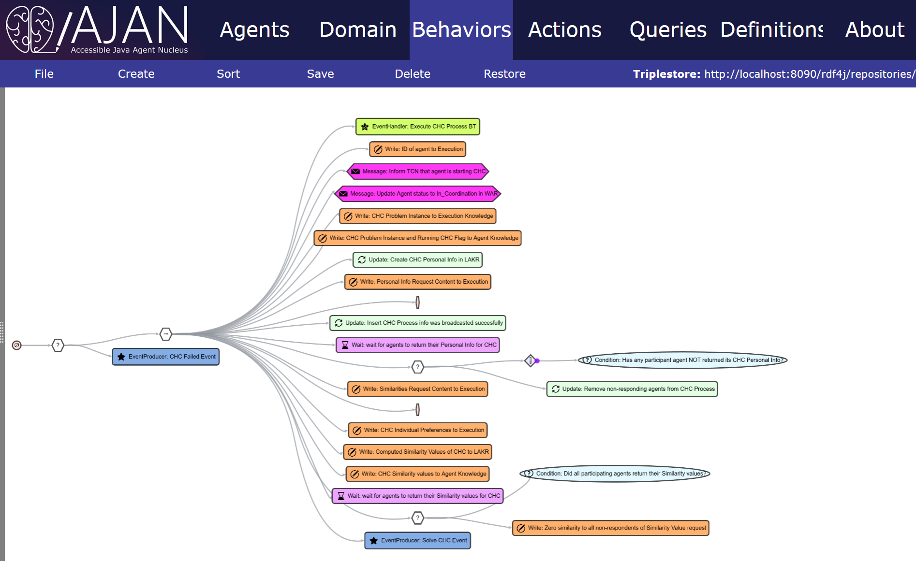

Slide 10
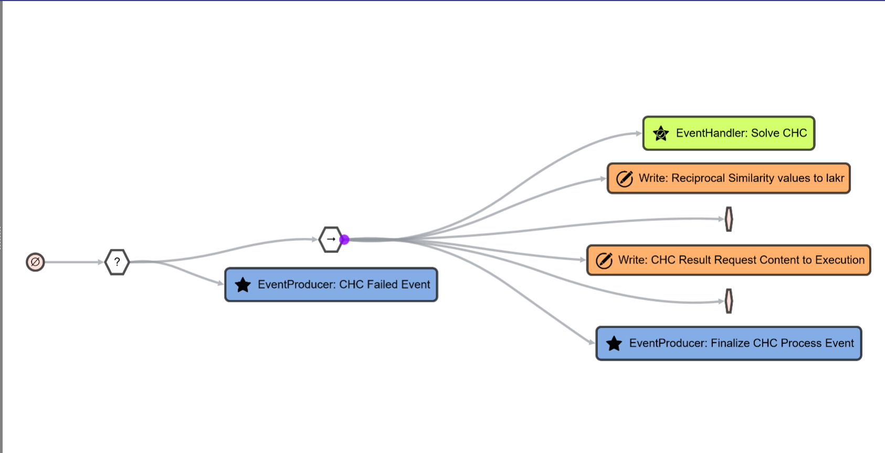

Slide 11
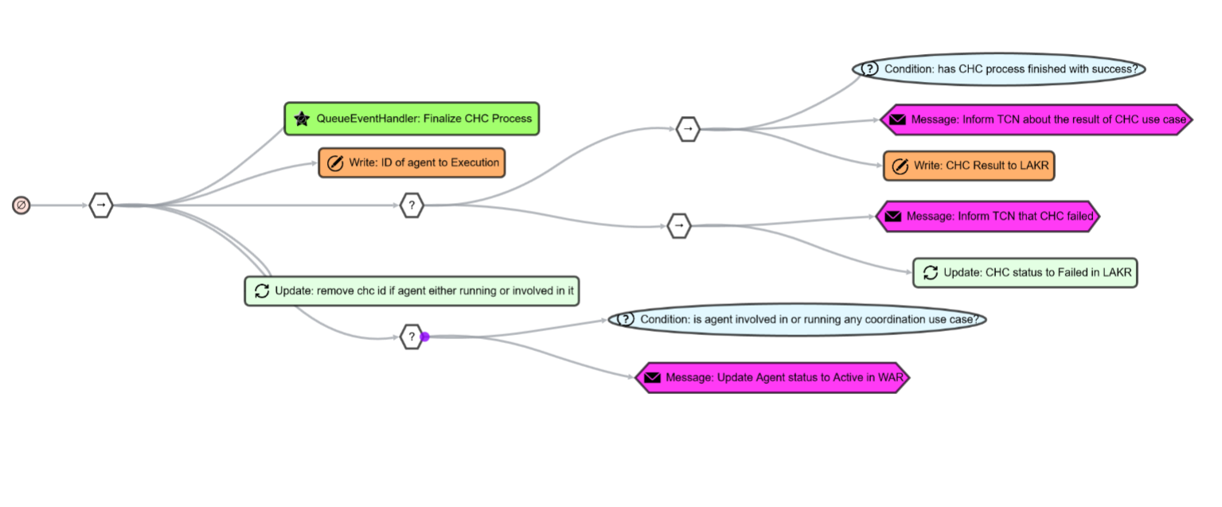

Slide 12
Thanks!

